Slide 1
Intelligent Agents

Slide 2
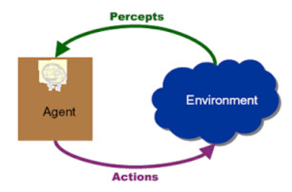
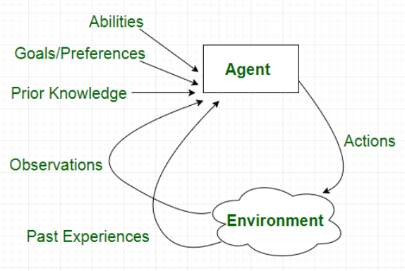
Introduction
An AI system is composed of an agent and its environment.
An agent perceives its environment through sensors.
The complete set of inputs at a given time is called a percepts.
The agent can change the environment through actuators or effectors.
An operation involving an effector is called Action – group of actions - action sequences.
An agent is anything that can be viewed as
  perceiving its environment through sensors and
  acting upon that environment through actuators
It’s a system that implements a mapping from percept sequences to actions. [f: P* → A]
A performance measure has to be used in order to evaluate an agent.
An autonomous agent decides autonomously which action to take in the current situation to maximize progress towards its goals.

Slide 3
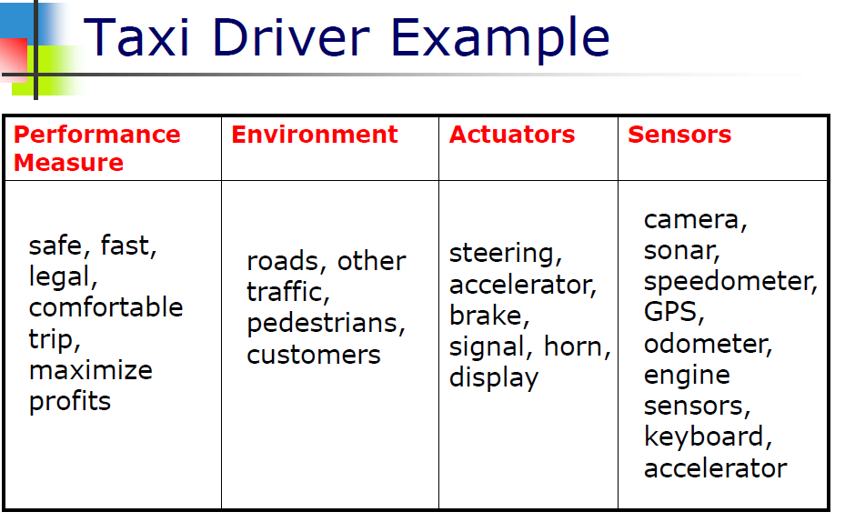
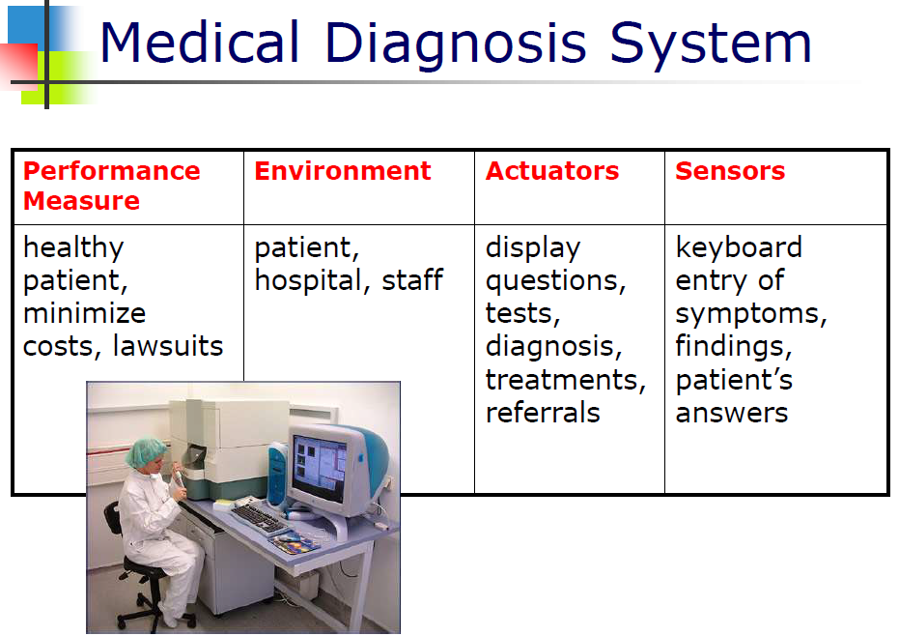
PEAS - Performance, Environment, Actuators, Sensors
Example Medical Diagnosis System
Example Taxi Driver

Slide 4
The Structure of Intelligent Agents
Agent = Architecture + Agent Program
Architecture = the machinery that an agent executes on.
Agent Program = an implementation of an agent function.
The job of AI is to design the agent program that implements the agent function mapping percepts to actions
Aim: find a way to implement the rational agent function concisely
  it takes the current percept as input from the sensors and returns an action to the actuators
Agent program takes the current percept as input - Nothing is available from the environment
Agent function takes the entire percept history - To do this, remember all the percepts

Slide 5
Characteristics of an intelligent agent
Rationality : Perfect Rationality assumes that the rational agent knows all and will take the action that maximizes her utility. Rational Action is the action that maximizes the expected value of the performance measure given the precept sequence to date.
Bounded Rationality : The property of an agent that behaves in a manner that is nearly optimal with respect to its goals as its resources will allow –an intelligent agent will be expected to act optimally to the best of its abilities and its resource constraints under the agent environment.
Agent Environment : Environments in which agents operate can be defined in different ways.
Observability : In terms of observability, an environment can be characterized as fully observable or partially observable.
In a fully observable environment all of the environment relevant to the action being considered is observable - the agent does not need to keep track of the changes in the environment. Ex: chess playing system.
In a partially observable environment, the relevant features of the environment are only partially observable. Ex: A bridge playing program

Slide 6
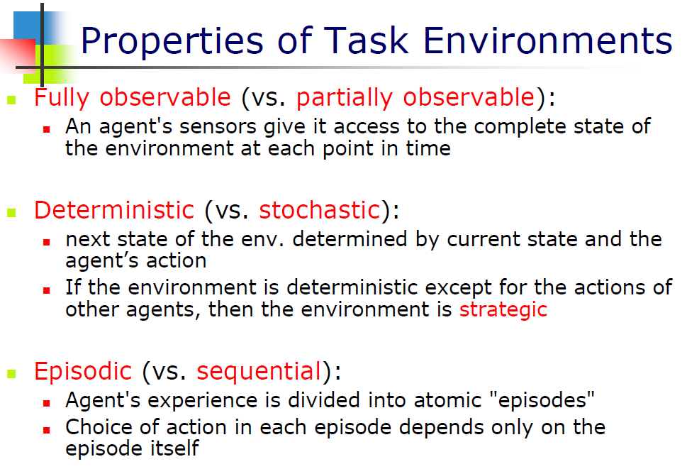
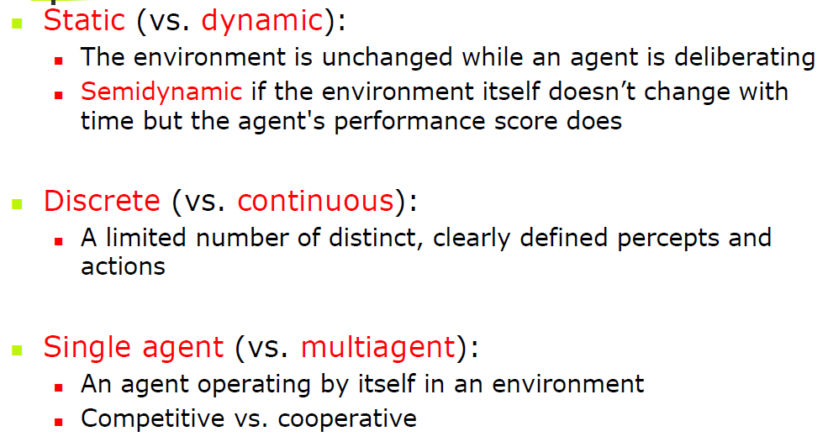

Slide 7
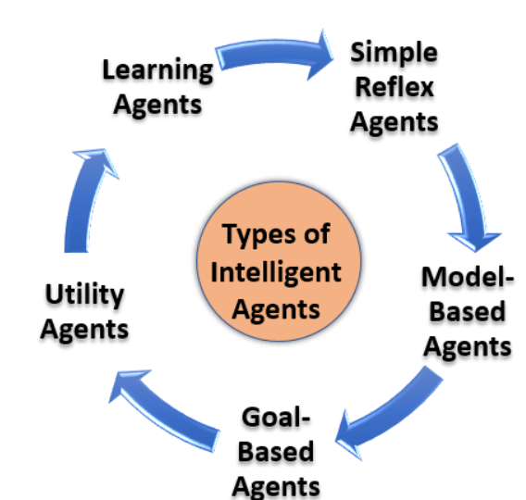
Types of Agents
Agents can be grouped based on their degree of perceived intelligence and capability :
  Simple Reflex Agents
  Model-Based Reflex Agents
  Goal-Based Agents
  Utility-Based Agents
  Learning Agent

Slide 8

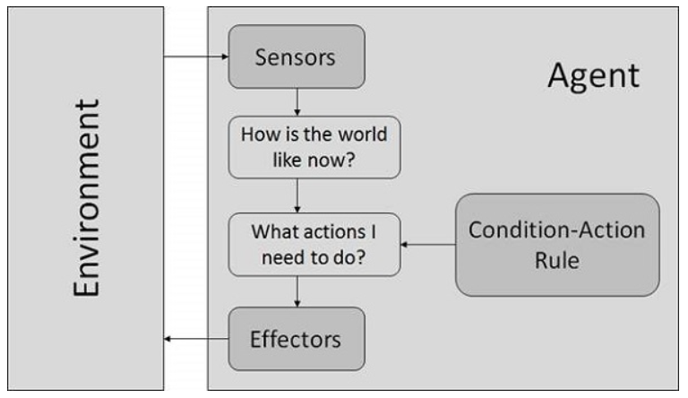
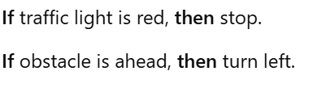


Simple reflex agents
Also known as simplest agents
basic form of agents and function only in the current state.
Very low intelligence capability as they don’t have the ability to store past state.
Respond to events based on pre-defined rules (pre-programmed) – They hold a static table from where they fetch all the pre-defined rules for acting.
They perform well only when the environment is fully observable.
It follows Condition-action rule -- the agent will map the current state to action.
No knowledge of non-perceptual parts of state.
If there occurs any change in the environment,
then the collection of rules need to be updated.
Notes:
A Simple Reflex Agent selects actions based on the current percept only, using if-then (condition-action) rules.

Slide 9
Model-based reflex agents
Advanced version of the Simple Reflex agent.
It can also respond to events based on the pre-defined conditions -- and can store the internal state (past information) based on previous events.
To perform any action, it relies on both internal state and current percept.
works by finding a rule whose condition matches the current situation.
It works in a partially observable environment and prefers to track the state.
It has two important parts:
  Model: it means “how things happen in the world,”-known as a Model-based agent.
  Internal State: Representation of the current state depending on percept history.
Updating the state requires information about:
  how the world evolves in-dependently from the agent, and
  how the agent actions affects the world.
Notes:
Model-Based Reflex Agents are more advanced than Simple Reflex Agents.
They maintain an internal model of the environment, which allows them to make better decisions even when some information is missing or not directly perceptible.
Robot Vacuum Cleaner:
Percept: Current location is dirty.
Model: Knows where it has cleaned already and where walls are.
Internal State: Updates map of rooms, obstacles, and dirt.
Action: Move to dirty area or return to charging station.

Slide 10
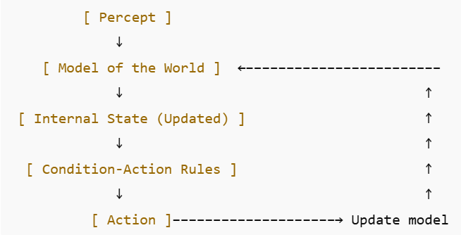
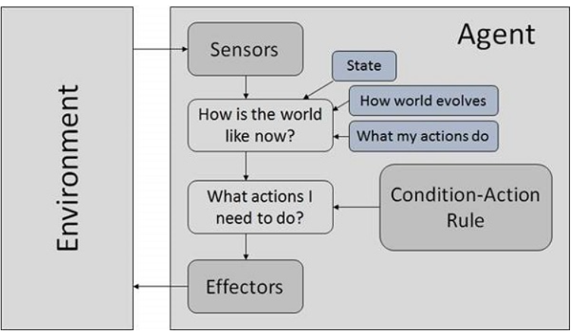
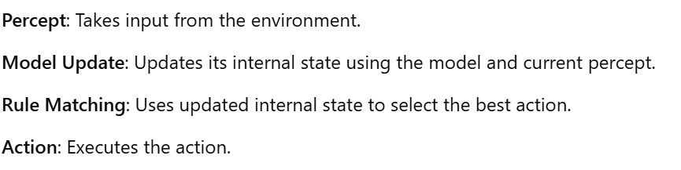
Model-based reflex agents
Notes:
Model-Based Reflex Agents are more advanced than Simple Reflex Agents.
They maintain an internal model of the environment, which allows them to make better decisions even when some information is missing or not directly perceptible.
Robot Vacuum Cleaner:
Percept: Current location is dirty.
Model: Knows where it has cleaned already and where walls are.
Internal State: Updates map of rooms, obstacles, and dirt.
Action: Move to dirty area or return to charging station.

Slide 11
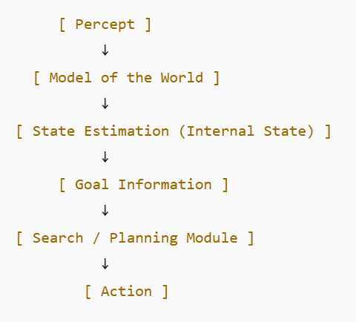
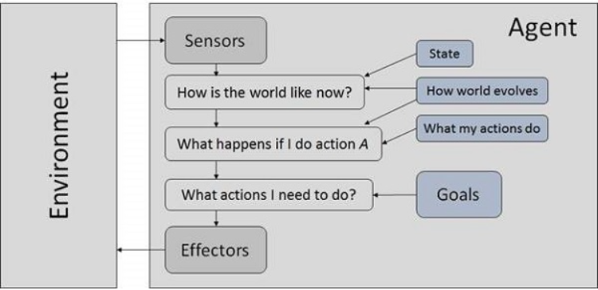
Goal Based Agents
Goal - the description of desirable situations, Goal-Based Agents select their actions to get goals
The current state environment knowledge is not enough to make a decision for an agent to what to do.
The action taken by these agents depends on the distance from their goal (Desired Situation).
The actions are intended to reduce the distance between the current state and the desired state.
To attain its goal, it makes use of the search and planning algorithm.
One drawback of Goal-Based Agents is that they don’t always select the most optimized path to reach the final goal – this can be overcome by using Utility Agent
Notes:
A Goal-Based Agent is an intelligent agent that uses goals to guide its actions, often planning ahead and choosing actions that maximize the chance of achieving those goals.
Autonomous car with goal: Reach destination safely and quickly
Plans route (GPS), avoids traffic, changes path if needed.

Slide 12
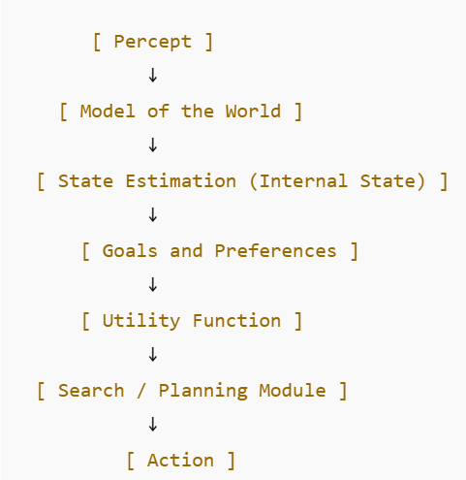
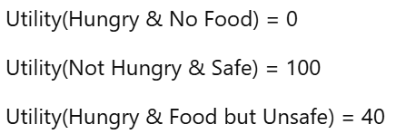
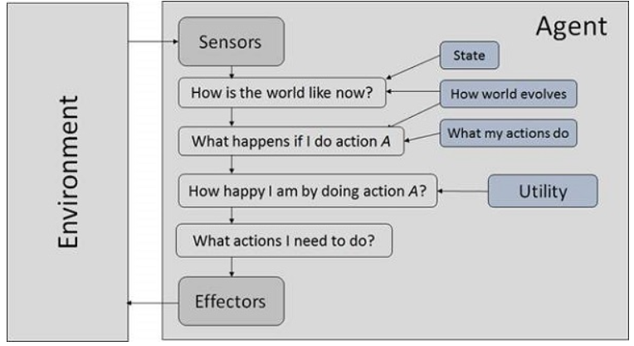
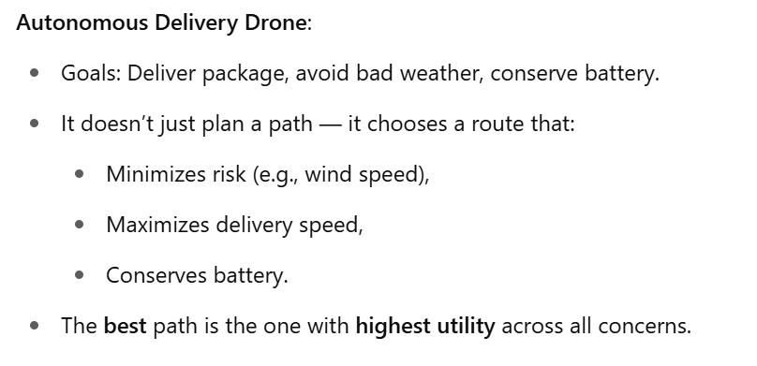
Utility Based Agents
The action taken by these agents depends on the end objective (preference), so they are called Utility Agent.
Utility Agents are used when there are multiple solutions to a problem, and the best possible alternative has to be chosen.
The alternative chosen is based on each state’s utility.
They perform a cost-benefit analysis of each solution and select one that can achieve the minimum cost goal.
Higher utility → more desirable state.
A mathematical function that maps states to real numbers.
Notes:
A Utility-Based Agent selects the action that results in the highest expected utility, not just any goal-achieving action.

Slide 13
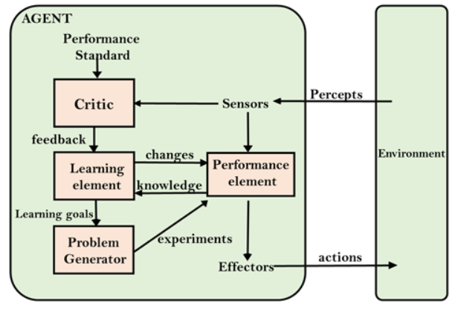
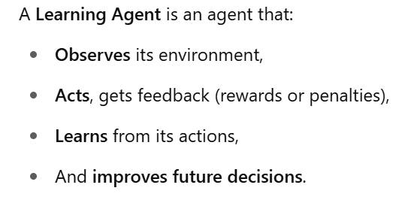
Learning Agent
Have learning abilities to learn from their past experiences.
These types of agents can start from scratch and, over time, can acquire significant knowledge from their environment.
It starts to act with basic knowledge and then able to act and adapt automatically through learning.
A learning agent has mainly four conceptual components:
  Learning element: It is responsible for making improvements by learning from environment
  Critic: Learning element takes feedback from critic which describes that how well the agent is doing with respect to a fixed performance standard.
  Performance element: responsible for selecting external action
  Problem generator: responsible for suggesting actions that will lead to new and informative experiences.

Slide 14
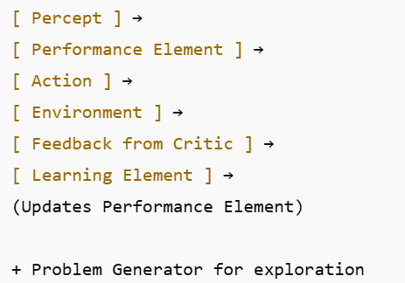
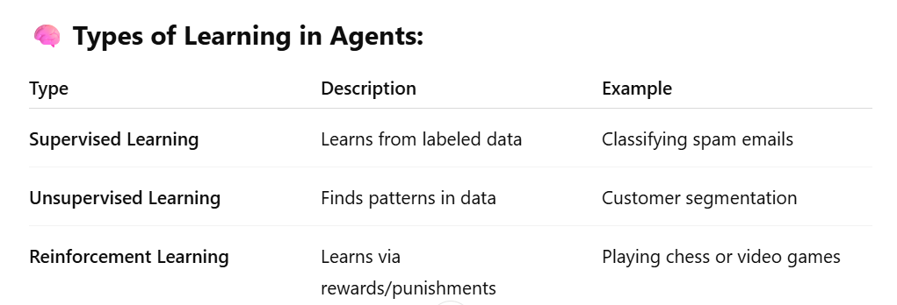
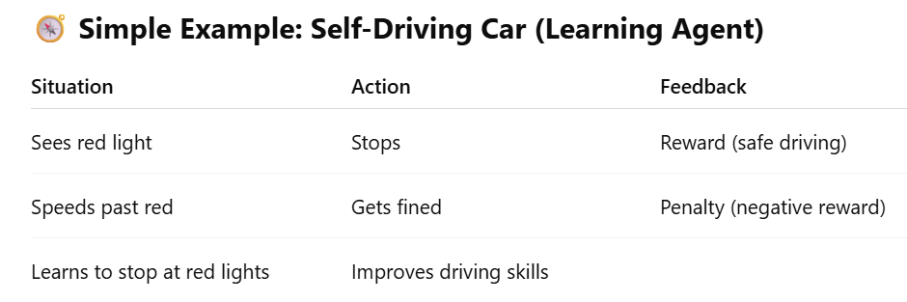
Notes:
Labeled data is a dataset where each example (input) is paired with the correct output.
Unlabeled data is a dataset where no target/output/label is given for the inputs.

Slide 15
Problem Solving Approach to
Typical AI problems

Slide 16
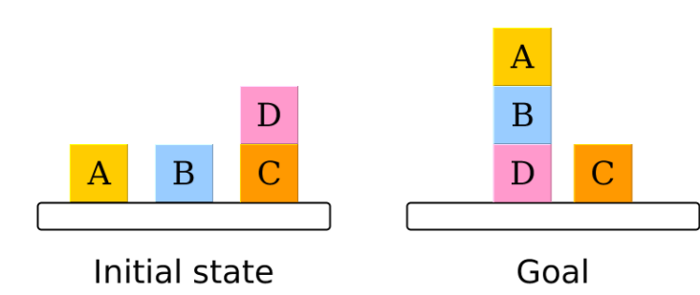
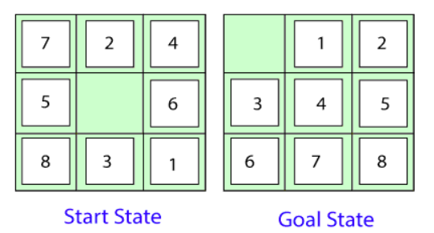
Introduction: Problem-solving
Problem-solving is commonly known as the method to reach the desired goal or finding a solution to a given situation.
In computer science, problem-solving refers to artificial intelligence techniques, including various techniques such as forming efficient algorithms, heuristics, and performing root cause analysis to find desirable solutions.
The reflex agent of AI directly maps states into action. Whenever these agents fail to operate in an environment where the state of mapping is too large and not easily performed by the agent, then the stated problem dissolves and sent to a problem-solving domain which breaks the large stored problem into the smaller storage area and resolves one by one. The final integrated action will be the desired outcomes.

Slide 17
Problem-solving agent
The problem-solving agent preforms precisely by defining problems and its several solutions.
“A problem-solving refers to a state where we wish to reach to a definite goal from a present state or condition.”
According to computer science, a problem-solving is a part of artificial intelligence which encompasses a number of techniques such as algorithms, heuristics to solve a problem.
Therefore, a problem-solving agent is a goal-driven agent and focuses on satisfying the goal.

Slide 18
Steps performed by Problem-solving agent
Goal Formulation: First and simplest step in problem-solving. It organizes the steps/sequence required to formulate one goal out of multiple goals as well as actions to achieve that goal. Goal formulation is based on the current situation and the agent’s performance measure
Problem Formulation: It is the most important step of problem-solving which decides what actions should be taken to achieve the formulated goal.
There are following five components involved in problem formulation:
  Initial State: It is the starting state or initial step of the agent towards its goal.
  Actions: It is the description of the possible actions available to the agent.
  Transition Model: It describes what each action does.
  Goal Test: It determines if the given state is a goal state.
  Path cost: It assigns a numeric cost to each path that follows the goal. The problem-solving agent selects a cost function, which reflects its performance measure. Remember, an optimal solution has the lowest path cost among all the solutions.

Slide 19
Initial state, actions, and transition model together define the state-space of the problem implicitly.
State-space of a problem is a set of all states which can be reached from the initial state followed by any sequence of actions.
The state-space forms a directed map or graph where nodes are the states, links between the nodes are actions, and the path is a sequence of states connected by the sequence of actions.
Search: It identifies all the best possible sequence of actions to reach the goal state from the current state. It takes a problem as an input and returns solution as its output.
Solution: It finds the best algorithm out of various algorithms, which may be proven as the best optimal solution.
Execution: It executes the best optimal solution from the searching algorithms to reach the goal state from the current state

Slide 20
Example Problems
Basically, there are two types of problem approaches:
Toy Problem:
  It is a concise and exact description of the problem which is used by the researchers to compare the performance of algorithms.
  Ex: 8 Puzzle Problem, Water-Jug Problem
Real-world Problem:
  It is real-world based problems which require solutions.
  Unlike a toy problem, it does not depend on descriptions, but we can have a general formulation of the problem.
  Ex: Traveling salesperson problem(TSP)

Slide 21
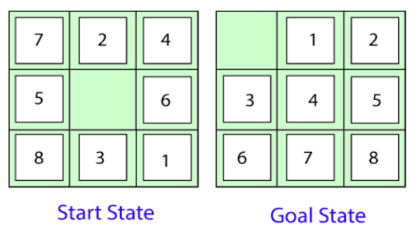
8 Puzzle Problem:
The 8 Puzzle Problem is a classic problem in artificial intelligence (AI) and is often used to teach problem-solving techniques, particularly in the areas of search algorithms and heuristic optimization.
Here, we have a 3×3 matrix with movable tiles numbered from 1 to 8 with a blank space. The tile adjacent to the blank space can slide into that space.
our task is to convert the current state into goal state by sliding digits into the blank space.

